Slide 1


Zomato Sales Analysis
Presented By Group-5

Slide 2




Meet Our Team
Ms. Shital Sanjay Aghav
Ms. Garuda Venya Varshitha
Mr. Alfej Nadaf
Ms. Priyanka Nitin patil
Mr. Vattem Ashish
Mr.Rashid Ansari md
Mr. Manjunath DN

Slide 3

Introduction
01
02 Overview
03
KPI’s
04 Insights & Recommendations
Agenda
05
Conclusion

Slide 4

This project analyzes a dataset of 9,551 restaurants to identify key business trends in the food service industry. The analysis focuses on restaurant growth over time, city and country-wise distribution, popular cuisines, pricing patterns, customer ratings, and service availability such as online delivery and table booking.
The project uses Excel for data preparation and summary analysis, Power BI and Tableau for interactive dashboards and visual insights, and SQL for accurate KPI calculations and data validation.
Over View

Slide 5

Total Restaurants
Restaurants by Country
Restaurants by City
Restaurants Opened by Year / Month
Average Cost for Two (USD)
Average Rating
Restaurants by Rating
Restaurants with Online Delivery (%)
Restaurants with Table Booking (%)
Cuisine-wise Restaurant Count
Top Cities by Number of Restaurants
KPI’s

Slide 6
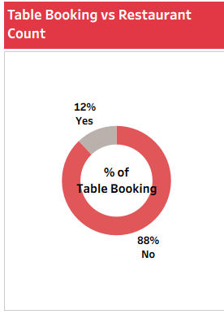
KPI 1
Table Booking vs Restaurant by Count:-
This KPI shows the adoption of the table booking feature among restaurants. Only 12% of restaurants offer table booking, while a significant 88% do not provide this service. This indicates that table booking is still underutilized in the market. Restaurants that enable table booking can improve customer convenience, reduce waiting time, and potentially increase customer satisfaction and repeat visits. The low adoption also presents a growth opportunity for restaurants to differentiate themselves by offering this service.

Slide 7
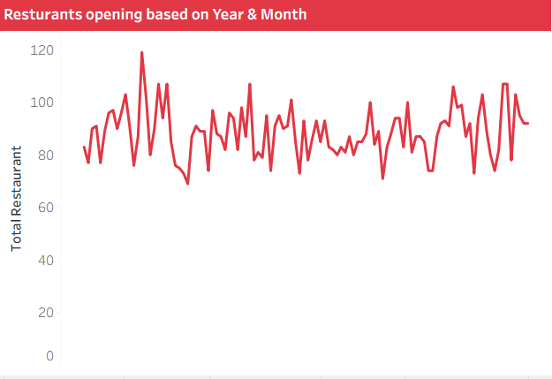
KPI 2
Resturants Opening based on year and month:-
This KPI shows the trend of restaurant openings over time at a monthly level. The chart indicates steady and consistent restaurant openings across years, with periodic peaks and dips that suggest seasonal or market-driven fluctuations. There is no sharp decline, which reflects stable growth in the restaurant industry. Higher peaks in certain months indicate favorable business periods for new openings, while lower points may reflect off-season effects. This KPI helps businesses identify best time periods for expansion and investment planning.

Slide 8
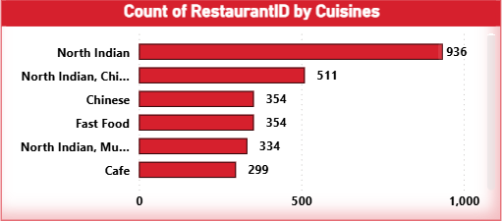
KPI 3
Restaurant Count by its Cuisines:-
This KPI highlights the distribution of restaurants by cuisine type. North Indian cuisine dominates the market with the highest number of restaurants, followed by North Indian–Chinese combinations, Chinese, and Fast Food. This indicates strong customer demand for traditional and fast-service cuisines. Café and multi-cuisine formats also show significant presence, reflecting evolving dining preferences. The KPI helps businesses understand which cuisines are most popular and supports decisions related to menu planning, market entry, and competitive positioning.

Slide 9
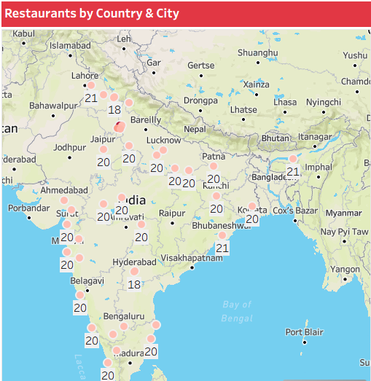
KPI 4
Restaurants by its Country and City :-
This KPI provides a geographical view of restaurant distribution across countries and cities. The map clearly shows a high concentration of restaurants in India, especially in major metropolitan cities such as Delhi, Bengaluru, Mumbai, and Hyderabad. Urban regions dominate restaurant presence, indicating stronger customer demand, better infrastructure, and higher business opportunities in cities. This KPI helps identify high-density markets, compare regional performance, and support location-based expansion and investment decisions.

Slide 10
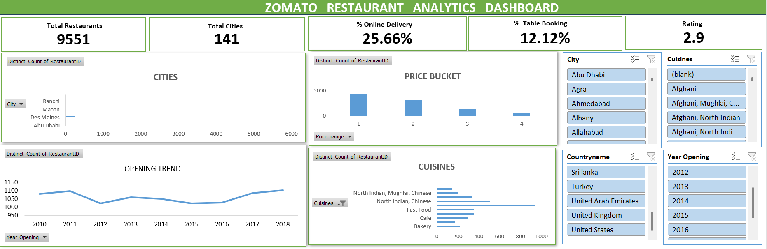
Olist Excel Dashboard

Slide 11
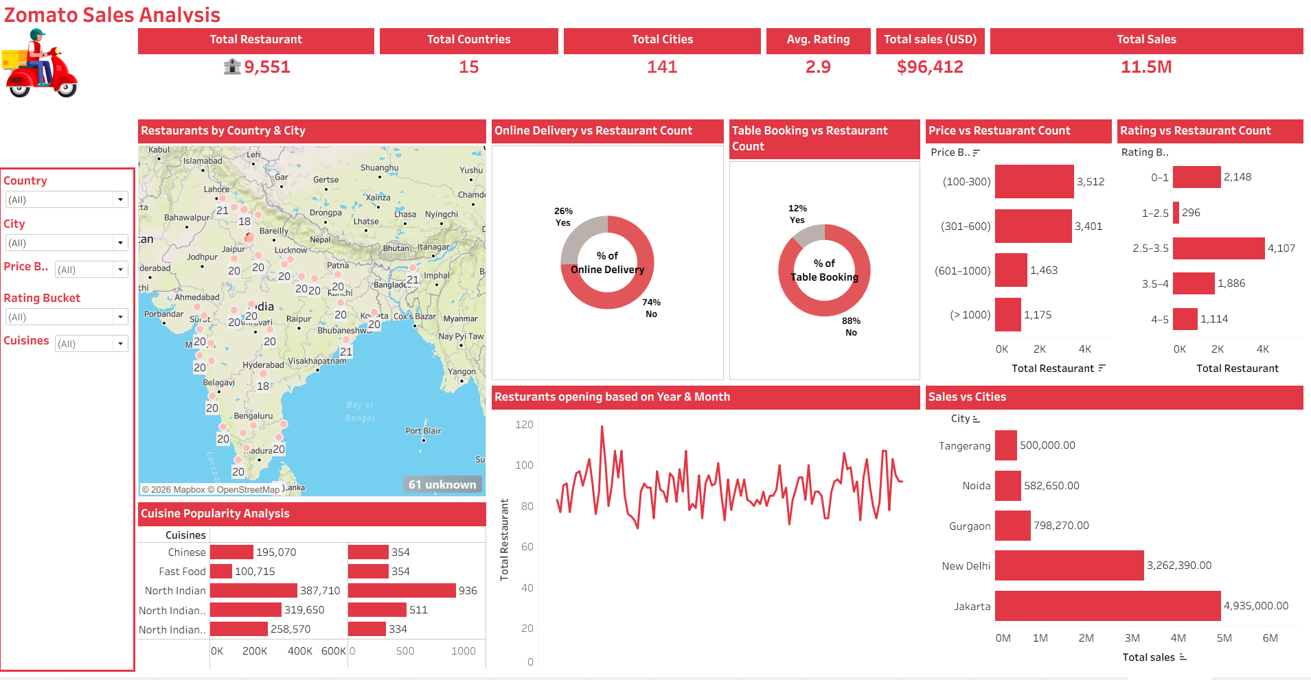
Olist Powerbi Dashboard

Slide 12
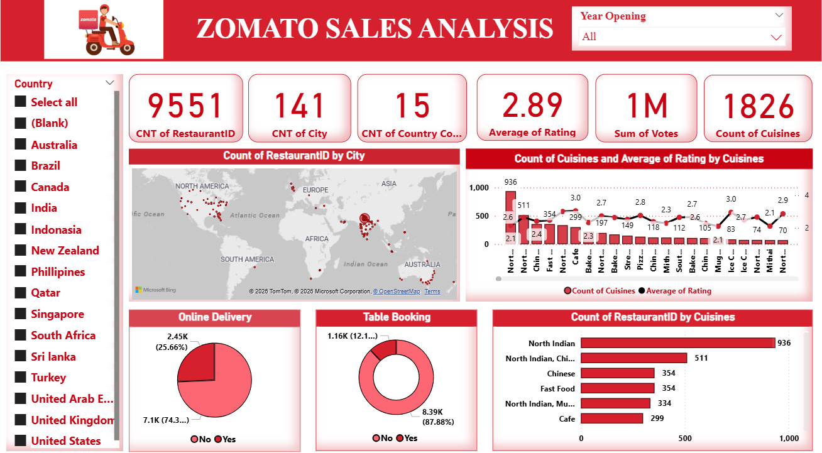
Olist Tableau Dashboard

Slide 13
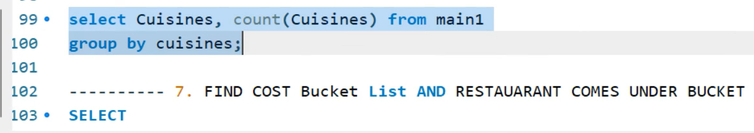
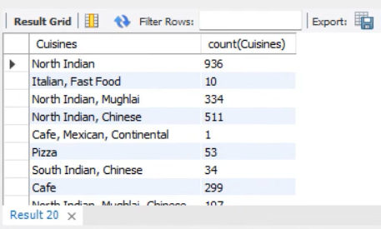
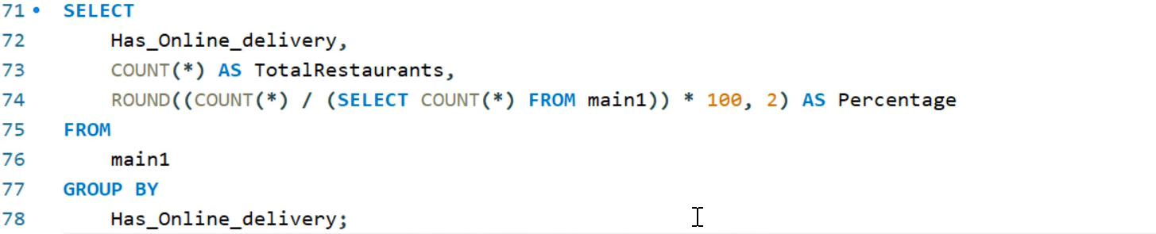
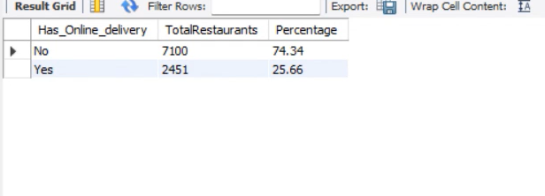
MY SQL(queries and output)
QUERIES
OUTPUT

Slide 14

This analysis is based on 9,551 restaurants and shows steady growth in restaurant openings over the years, especially after 2010, indicating rapid industry expansion. Most restaurants are concentrated in major cities, highlighting strong urban demand. Popular cuisines such as North Indian, Chinese, and Fast Food dominate the market, with multi-cuisine restaurants performing better in terms of ratings and customer votes. The majority of restaurants fall into low to medium price ranges, proving affordability is a key success factor. Restaurants offering online delivery and table booking show higher customer engagement. Overall, affordable pricing, popular cuisines, strong locations, and digital services drive better restaurant performance, and these insights are effectively analyzed using Excel, Power BI, Tableau, and SQL.
Insights

Slide 15

The analysis suggests that restaurants should focus on expanding in major urban cities where customer demand is highest and prioritize offering popular cuisines such as North Indian, Chinese, and Fast Food. Maintaining affordable to mid-range pricing can help attract a larger customer base, while introducing multi-cuisine menus can improve customer satisfaction, ratings, and votes. Enabling digital services like online delivery and table booking is strongly recommended, as these features drive higher customer engagement. Restaurants should also closely monitor ratings and customer feedback to improve service quality and use time-based trends to plan openings and promotions during high-demand periods for better business performance.
Recommendations

Slide 16

This project analyzes 9,551 restaurants to understand growth, location, cuisine, pricing, ratings, and service trends. The results show strong urban concentration, high demand for popular cuisines, preference for affordable pricing, and better performance for restaurants offering digital services. Overall, combining the right location, popular menu options, reasonable pricing, and online features leads to higher customer engagement and business success.
Summary

Slide 17

This analysis demonstrates that data-driven decision-making plays a critical role in understanding restaurant performance and market trends. The findings clearly show that location, cuisine type, pricing strategy, and service availability strongly influence customer behavior and business success. Restaurants located in major cities, offering popular and multiple cuisines at affordable prices, consistently receive higher ratings and customer engagement. Additionally, the availability of online delivery and table booking services enhances customer convenience and increases overall visibility and reach. By leveraging analytical tools such as Excel for reporting, Power BI and Tableau for interactive visualization, and SQL for accurate data processing,
Conclusion

Slide 18
Timeline
Mon | Tue | Wed | Thu | Fri | Sat | Sun
22 Dec 25
Project Kick-off Meeting & Understand the Dataset and KPI’s
29 Dec 25
Implementation of KPI’s using Excel
5 Jan 26
Implementation of KPI’s using Tableau
12 Jan 26
Implementation of KPI’s using Power BI
19 Jan 26
Final project presentation and KPI’s using Sql

Slide 19






